Slide 1
Fauvism and Symbolism
On the following slides, you will find a statement and a true or false qualifier. Based on the statements, write a definition for Fauvism and Symbolism.

Slide 2
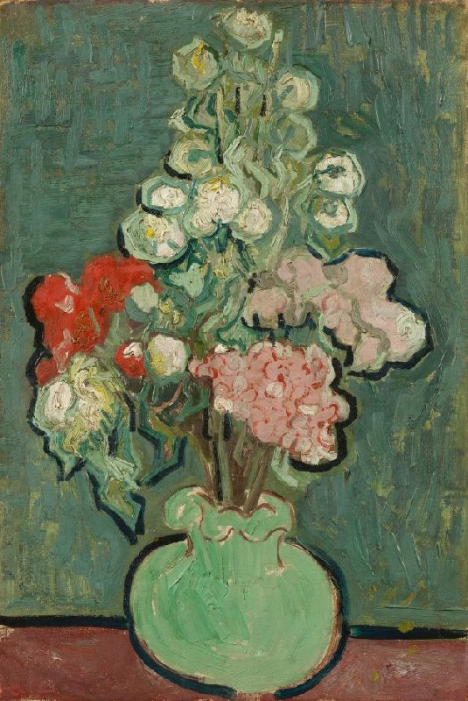
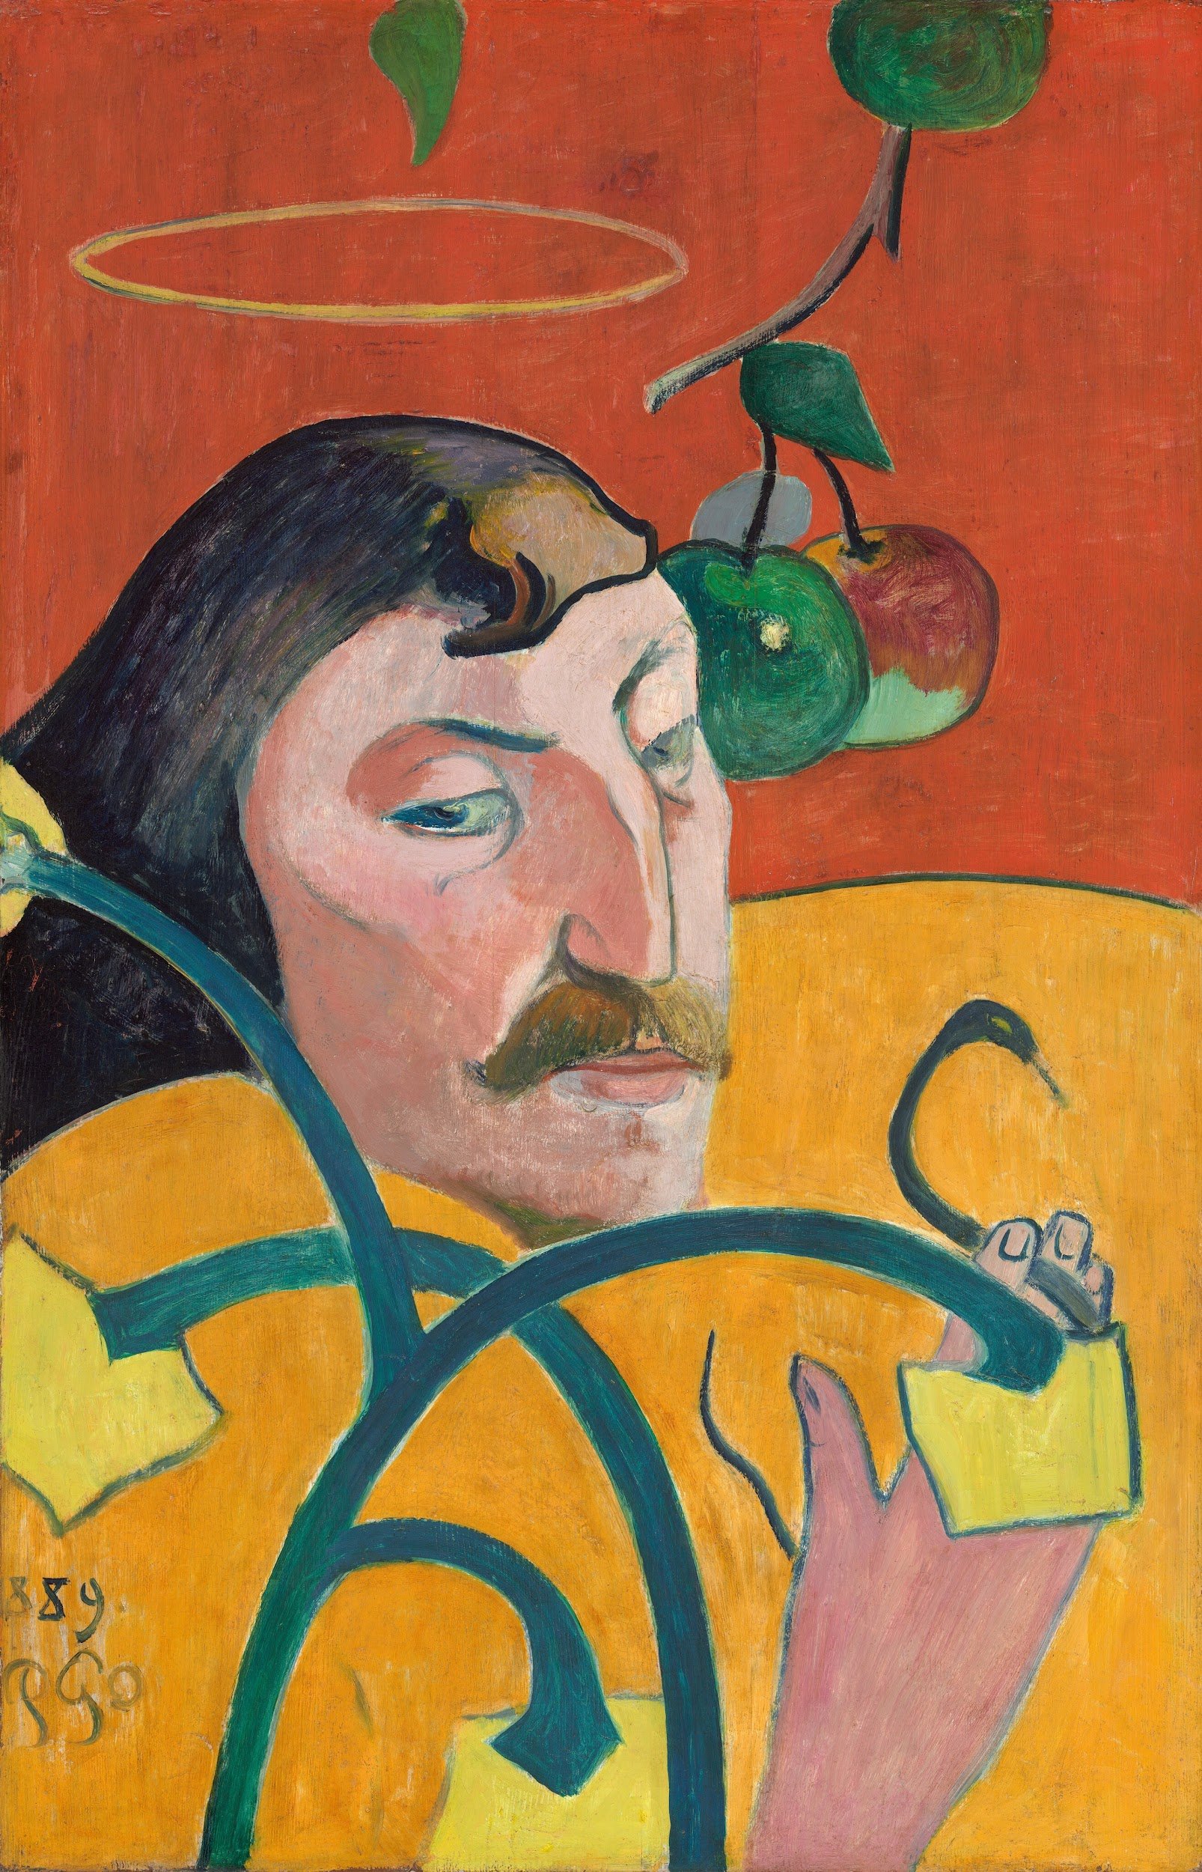
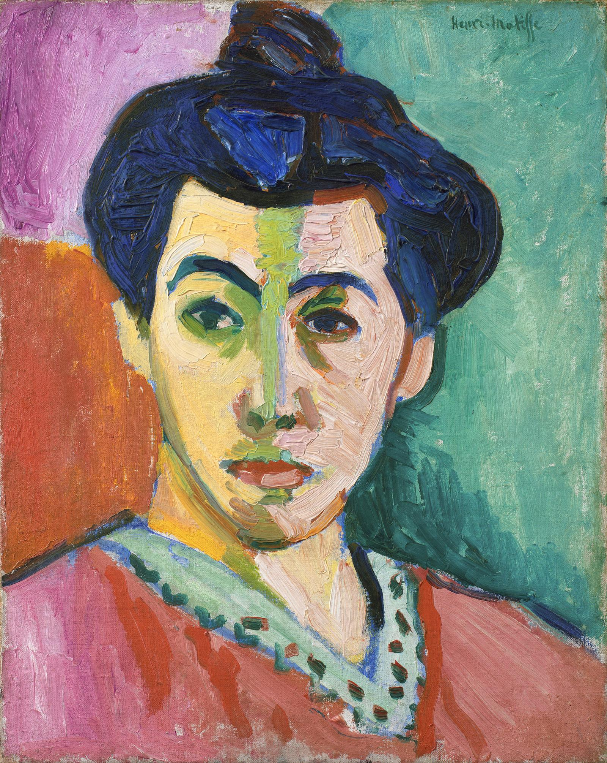
It is …
Henri Matisee, The Green Line, 1905, National Gallery of Denmark
Vincent van Gogh, Vase of Flowers, 1890, van Gogh Museum
Paul Gauguin, Self Portrait, 1889, National Gallery of Art

Slide 3
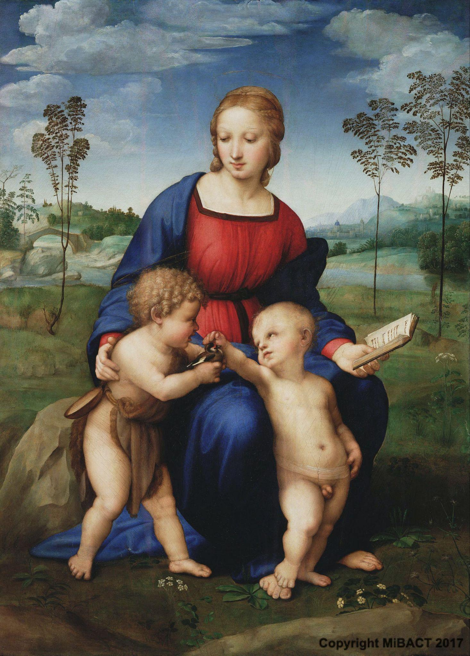
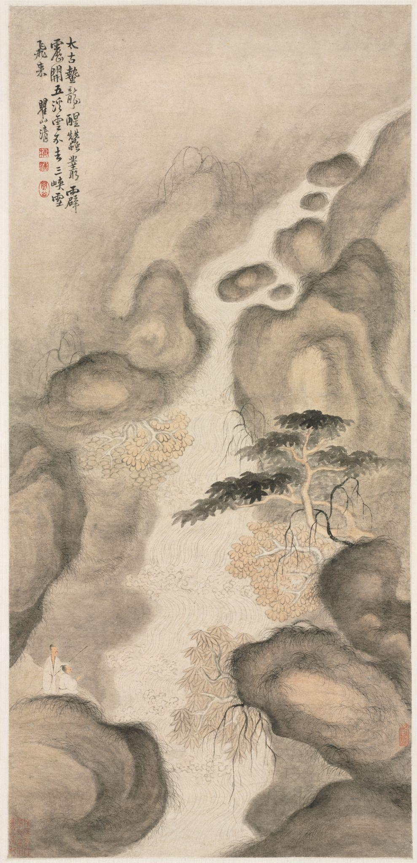
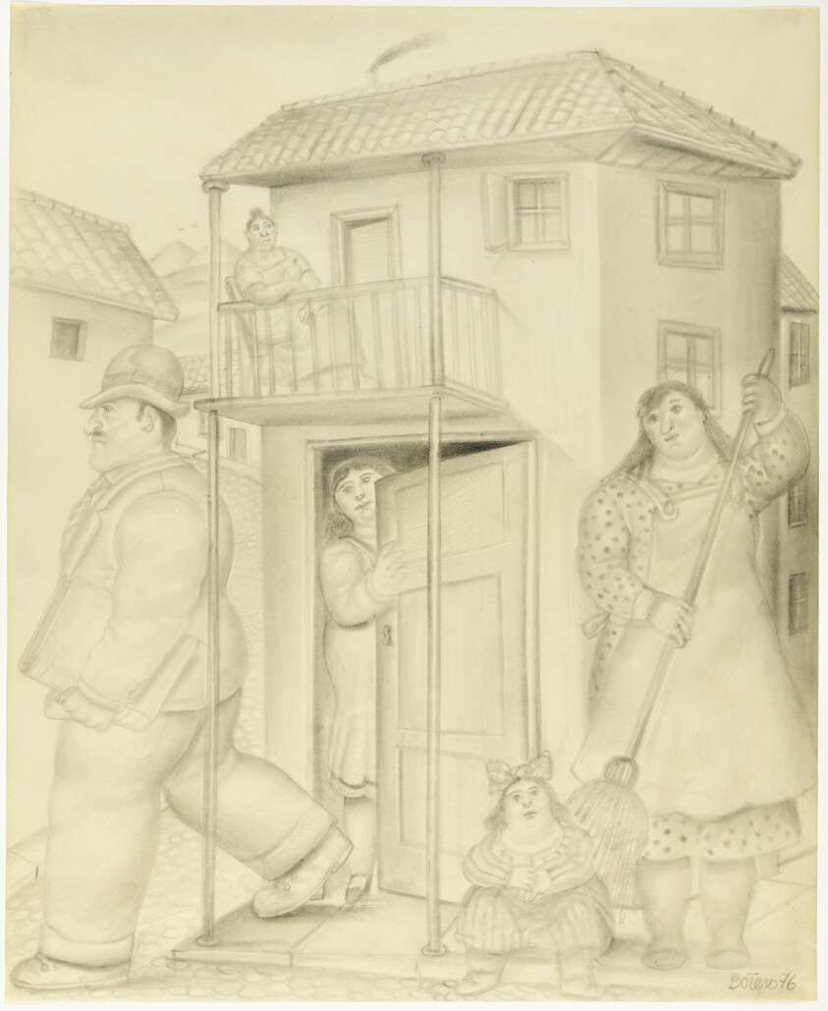
It is not …
Fernando Botero, Street Scene, 1976, Chicago Art Institute
Raphael,Madonna of the Goldfinch, 1506, Uffizi Gallery
Mei Qing, Nine Dragon Pool, 1690’s, Cleveland Museum of Art

Slide 4
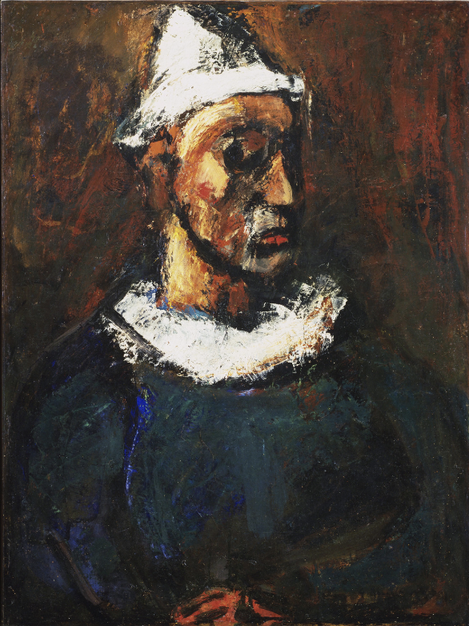
It is …
Painting from mid 19th to early 20th century.
Traditional subject matter, like portraits, still life, and landscapes.
Uses atypical colour from naturalism.
Communicates emotional through form.
Georges Rouault, The Clown, 1912, Museum of Modern Art

Slide 5
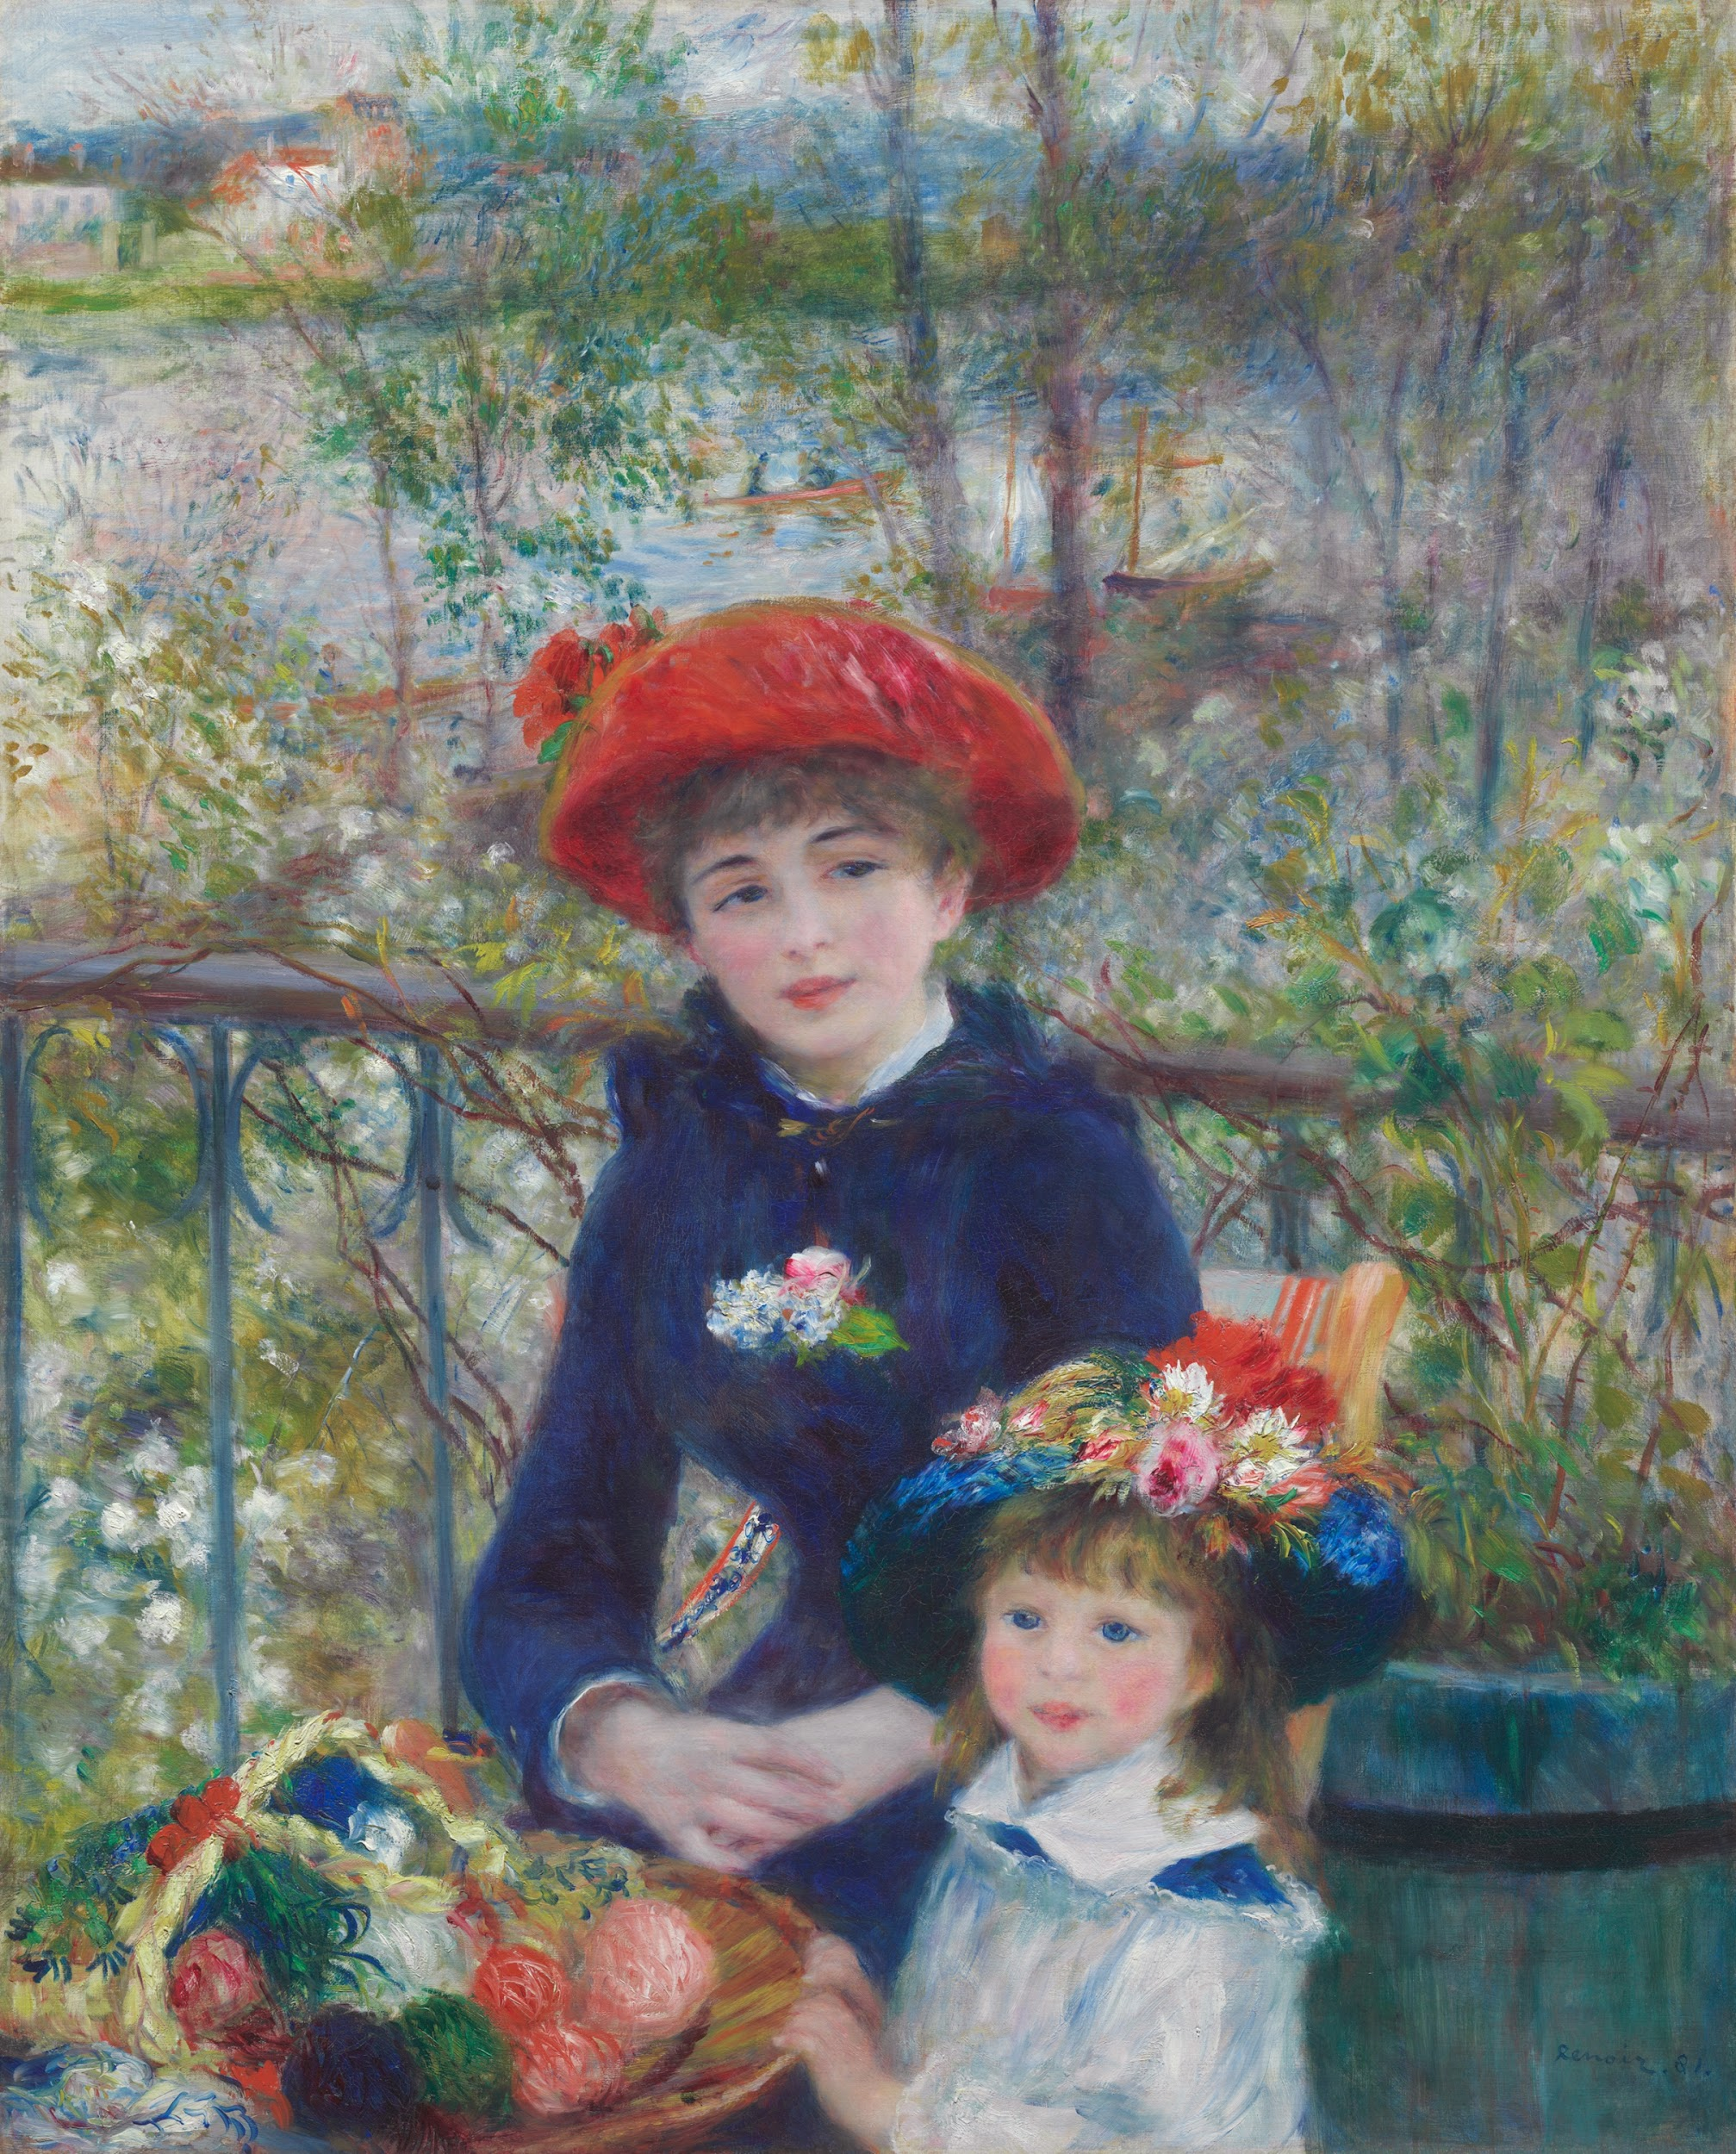
It is not
Impressionism
Cubism
After 1920
Historical painting
Pierre Auguste-Renoir, Two Sisters, 1881, Art Institute of Chicago

Slide 6
Fauvism and Symbolism
Is
Vincent van Gogh
Henri Matisee
Paul Gauguin
Raoul Dufy
Paul Cezanne
Georges Rouault
Is not
Leonardo da vinci
Pablo Picasso
Gerhad Richter
Jackson Pollack
Artismia Gentileschi

Slide 7
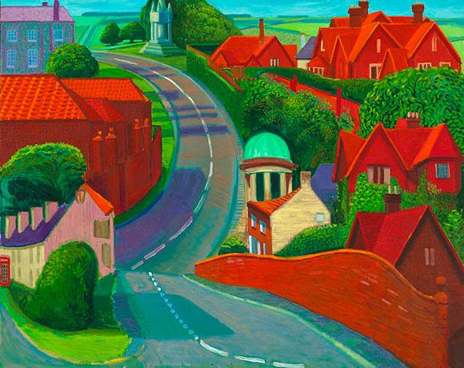
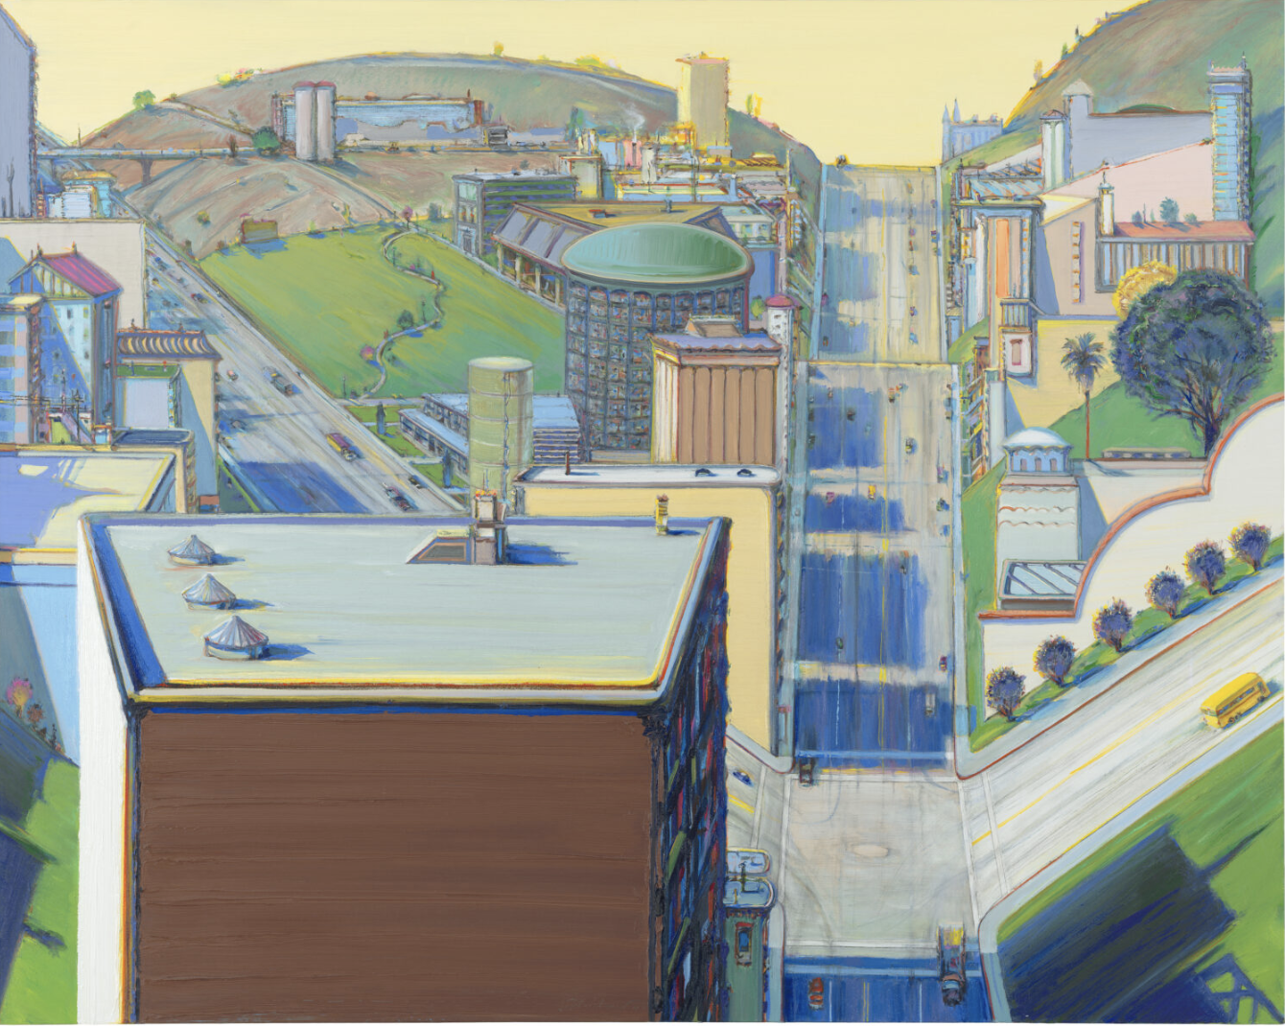
It is not … (but it look like it, right?)
David Hockney, Road to York through Sledmere, 1997, Collection of the artist.
Wayne Thiebaud, Valley Streets, 2003, SFMOMA

